Slide 1
Project Schedule Management Knowledge Area
Week 7→ Lecture 13&14
By
Humaira Afzal
Lecturer CS, CUI Lahore Campus

Slide 2
Project Schedule Management
Project Schedule Management includes the processes required to manage the timely completion of the project.
The Project Schedule Management processes are:
1. Plan Schedule.
2. Define Activities
3. Sequence Activities
4. Estimate Activity Duration
5. Develop Schedule
6. Control Schedule

Slide 3
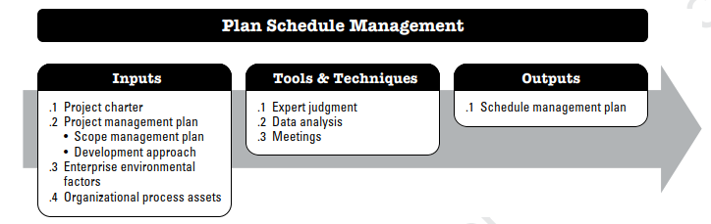
Plan Schedule Management
- Occurs in the Planning Process Group.
- Concerned with establishing procedures, policies, planning, managing, and documenting the project schedule.
- Create the schedule management plan.

Slide 4
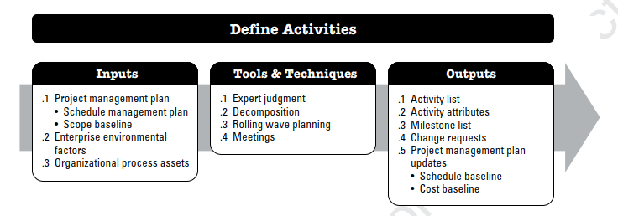
Define Activities
- Planning Process Group
- A process of identifying and documenting the speciﬁc actions to be performed to produce the project deliverables.
- Decomposes work packages into smaller activities that provide a basis for estimating, scheduling, executing, monitoring, and controlling the project work.

Slide 5
Define Activities
Activity List: The project activities need to be performed.
Activity Attributes: Details regarding the activity list.
Milestones: Key events that occur in the project. They are not any activity and have no duration.

Slide 6
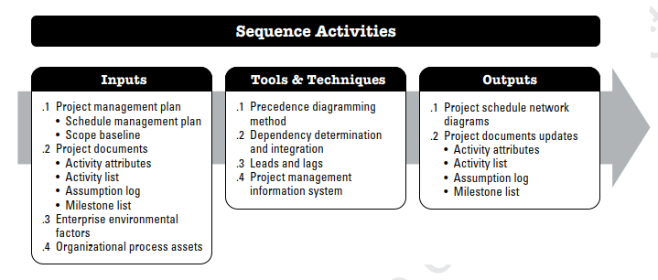
Sequence Activities
- Planning Process Group
- Sequence Activities is the process of identifying and documenting relationships among the project activities.

Slide 7
Precedence Diagramming Method
The precedence diagramming method (PDM) is a technique used for constructing a schedule model in which activities are represented by nodes and are graphically linked by one or more logical relationships to show the sequence in which the activities are to be performed.
A predecessor activity is an activity that logically comes before a dependent activity in a schedule.
A successor activity is a dependent activity that logically comes after another activity in a schedule.

Slide 8
Precedence Diagramming Method
Finish-to-start (FS). A logical relationship in which a successor activity cannot start until a predecessor activity has ﬁnished.
Finish-to-finish (FF). A logical relationship in which a successor activity cannot ﬁnish until a predecessor activity has ﬁnished. For example, writing a document (predecessor) is required to ﬁnish before editing the document (successor) can ﬁnish.
Start-to-start (SS). A logical relationship in which a successor activity cannot start until a predecessor activity has started. For example, level concrete (successor) cannot begin until the pour foundation (predecessor) begins.

Slide 9
Precedence Diagramming Method
Start-to-finish (SF). A logical relationship in which a successor activity cannot ﬁnish until a predecessor activity has started. The duty of the morning guard cannot finish until the duty of the evening guard starts.
In PDM, FS is the most commonly used type of precedence relationship. The SF relationship is very rarely used but is included to present a complete list of the PDM relationship types.

Slide 10
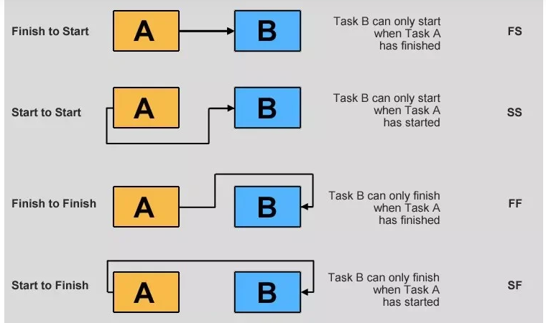

Slide 11
Sequence Activity Dependencies
Mandatory Dependency
A requirement that must be considered before another requirement can be worked on; The nature of the work can include this type of dependencies.
Mandatory dependencies are sometimes referred to as hard logic or hard dependencies.
where a prototype has to be built before it can be tested.
Discretionary dependencies.
Optional dependencies that can be removed or altered at the discretion of the project team.
A: Book Airline Ticket; B: Buy Travel Insurance – The project team can book an airline ticket before buying travel insurance or do it the other way around.

Slide 12
Sequence Activity Dependencies
External dependencies. Dependency that comes from outside the project such as organizational rules or government regulations.
Internal dependencies. The relationship between project activities may include resource availability and being able to move to the next activity.

Slide 13
Network Diagram
A project network diagram is a visual representation of the workflow of a project. It demonstrates the logical order that the activities will follow.
The Critical Path Method (CPM) and the Program Evaluation and Review Technique (PERT) use network diagrams in project management.
Project managers use these methods to estimate the duration of the project and create a project schedule.
Project network diagrams can be divided into two types, the arrow diagram method (ADM) and the precedence diagram method (PDM).
The main difference between an ADM and a PDM project network diagram is the way they represent the project tasks.

Slide 14
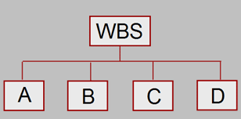
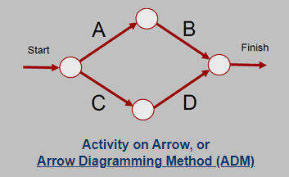
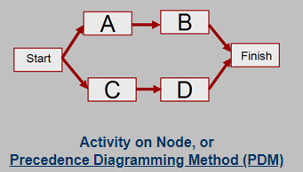
Network Diagram
In a PDM diagram, tasks are represented by boxes or circles. In an ADM diagram, tasks are represented by arrows.

Slide 15
Arrow Diagramming Method (ADM)
Also called activity-on-arrow (AOA) network diagrams
Activities are represented by arrows
Nodes or circles are the starting and ending points of activities
It Can only show finish-to-start dependencies

Slide 16
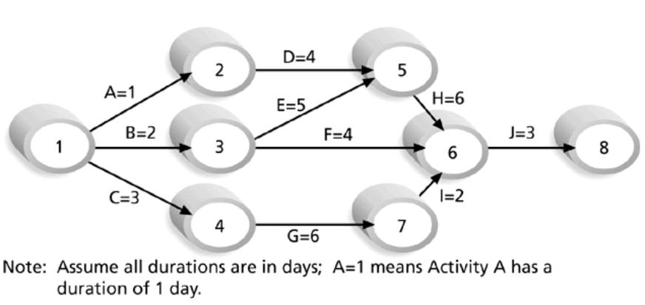
Sample Activity-on-Arrow (AOA) Network Diagram for Project X

Slide 17
Precedence Diagramming Method (PDM)
More popular than the ADM method and is used by project management.
Activities are represented by boxes.
Arrows show relationships between activities.
Better at showing different types of dependencies

Slide 18
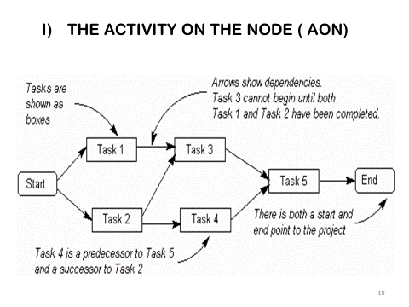

Slide 19
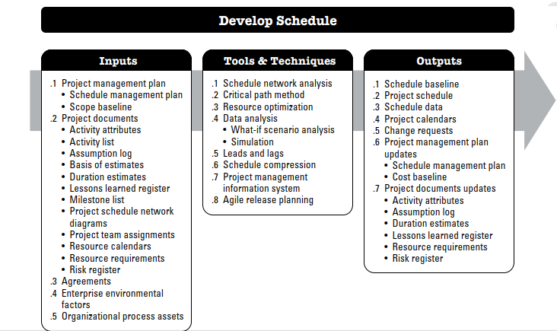
Develop Schedule
Using the outputs of the prior processes – Develop the project schedule with planned/estimated start and completion dates.

Slide 20
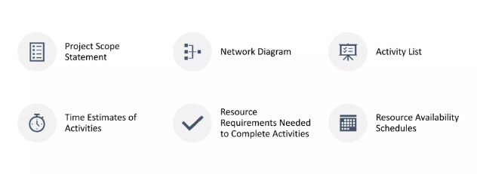
Requirements to complete a schedule

Slide 21
Critical Path Method (CPM)
CPM is a network diagramming technique used to predict total project duration.
A critical path for a project is the series of activities that determines the earliest time by which the project can be completed.
The critical path is the path that has the least amount of slack or float.
Slack or float is the amount of time an activity may be delayed without delaying a succeeding activity or the project finish date.

Slide 22
Critical Path Method (CPM)
1. Activity
An activity is a part of the project denoted by an arrow or a node on the network.
2. Dummy Activity
The activity that neither uses any resources nor any time for its completion is called a dummy activity. It is represented by a dotted arrow.
3. Event
Event is the stage or point where all previous jobs merging in it are completed and the jobs bursting out are still to be completed. Event 1 is the starting point of the project.

Slide 23
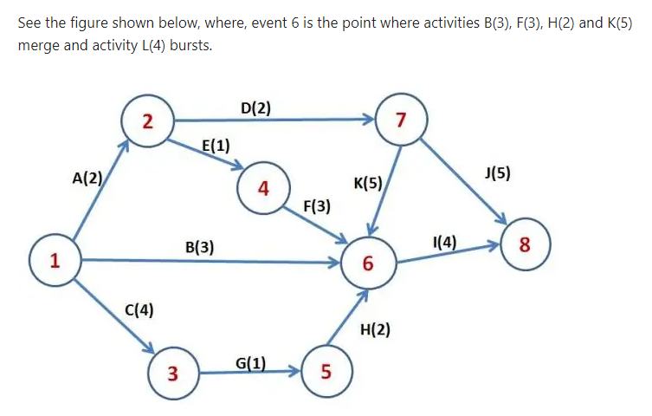

Slide 24
Critical Path Method (CPM)
Early Start Time (E.S.T.)
The earliest possible time at which an activity may start is called early start time.
Early Finish Time (E.F.T.)
The sum of the earliest start time of an activity and the time required for its completion is called early finish time.
Late Start Time (L.S.T.)
The latest possible time at which an activity may start without delaying the date of the project, is called late start time.

Slide 25
Critical Path Method (CPM)
Late Finish Time (L.F.T.)
The sum of the late start time of an activity and the time required for its completion is called late finish time.
Free float is the amount of time that a task can be delayed without impacting the subsequent task.
Total float is the amount of time a task or a project can be delayed without impacting the overall project completion time. Critical Path activities should be Zero float days.
Critical Path
The path in the network joining the critical events is called the critical path of the work.

Slide 26
Phases and Passes of Critical Path
There are two passes in CPM.
Forward Pass
Backward Pass
CPM has two phases
Early Start (ES) and Early Finish (EF) are considered as Forward Pass
Late Start (LS) and Late Finish (LF) are considered as Backward Pass
ES | Activity Name | EF
LS | Duration | LF

Slide 27
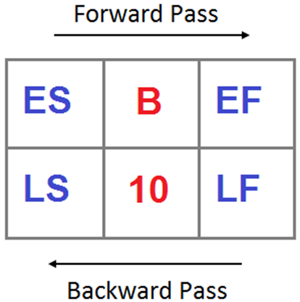
Steps to follow for Forward Pass and Backward Pass
Forward Pass
ES_{i} for first node is always zero
ES_{j} = max_{i} (ES_{i} + D_{ij})
EF_{i} = ES_{i} + D_{i}
Backward Pass
Start from last node backwards, LF_{j} = EF_{j}
LS_{j} = min_{j} (LF_{j} - D_{ij})
LS_{j} = LF_{i}
LF_{i} will become LS_{j} while back tracking

Slide 28
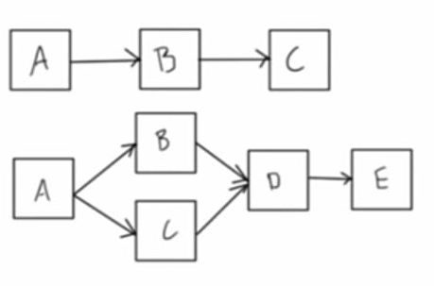
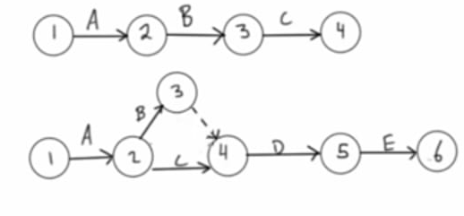
Network Diagram: PDM Vs CPM
PDM: Precedence Diagramming Method
CPM: Critical Path Method
“AON” Activity on Node
“AOA” Activity on Arrow”

Slide 29
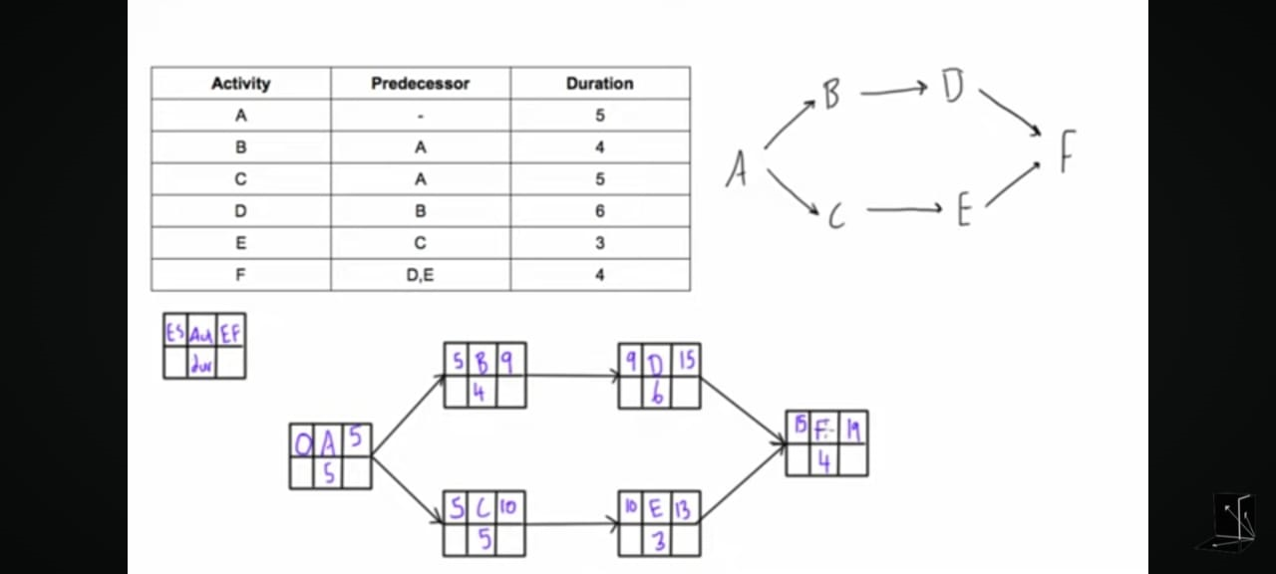

Slide 30
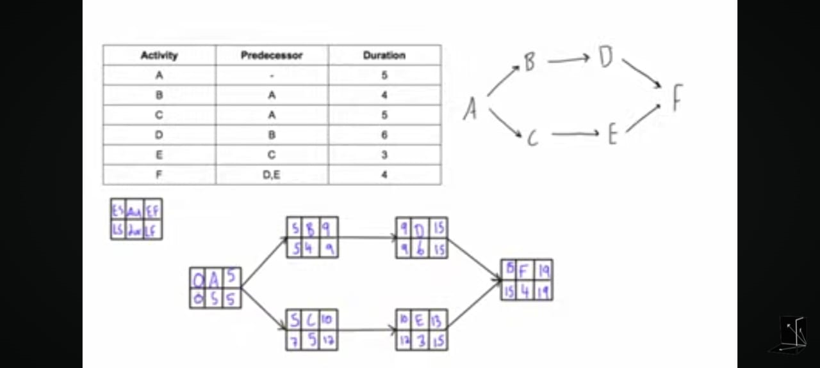

Slide 31
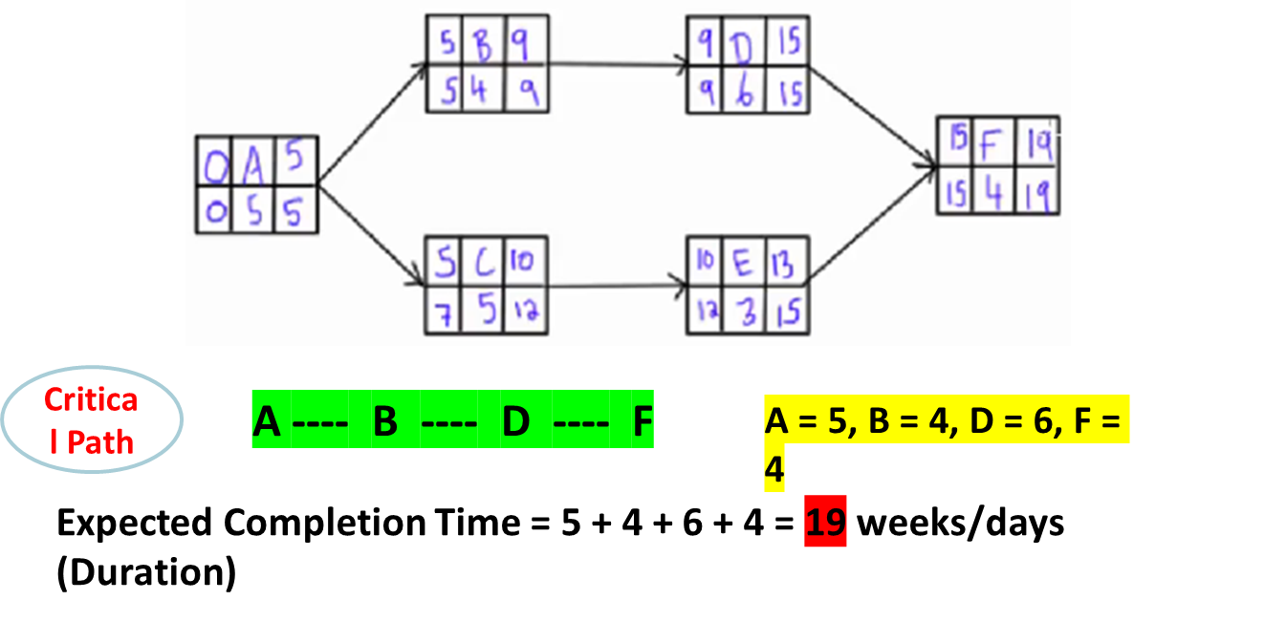

Slide 32
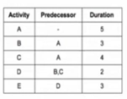
Question 1
1: Draw a Network Diagram. Using a standard node convention to display the duration.
2. Apply forward and backward pass.
3. What is the critical path?
4. What is the project’s expected duration?
5: Calculate Float?

Slide 33
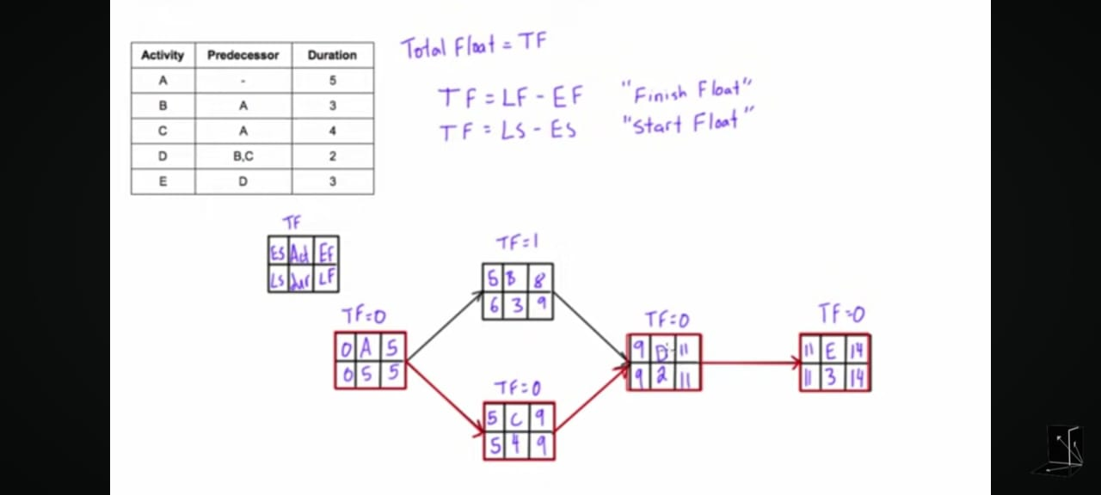

Slide 34
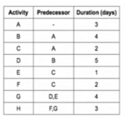
Question 2
1: Draw a Network Diagram. Using a standard node convention to display the duration.
2. Apply forward and backward pass.
3. What is the critical path?
4. What is the project’s expected duration?
5: Calculate Float?

Slide 35
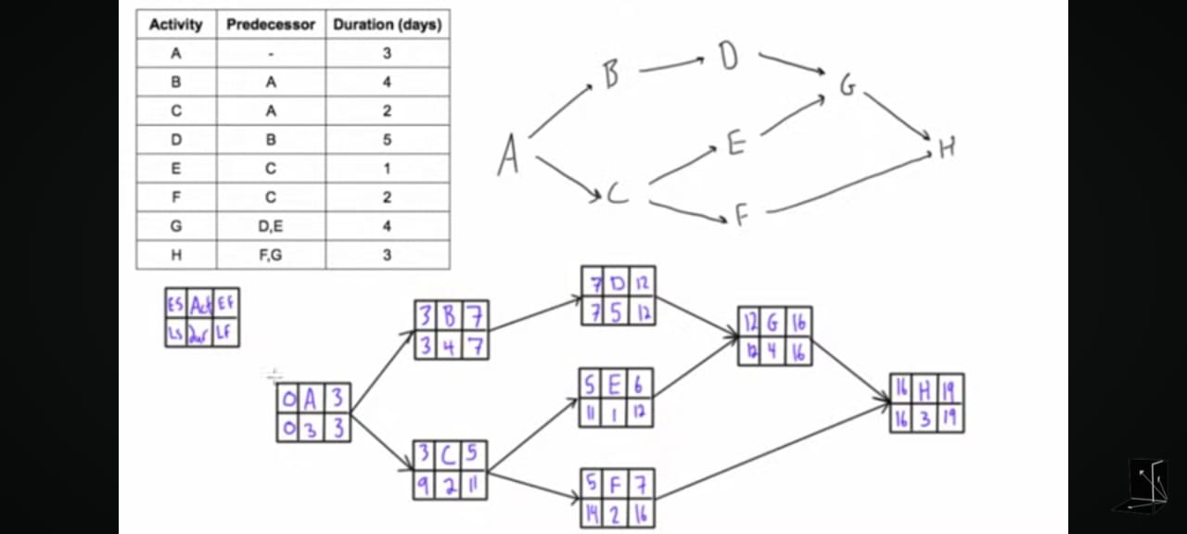

Slide 36
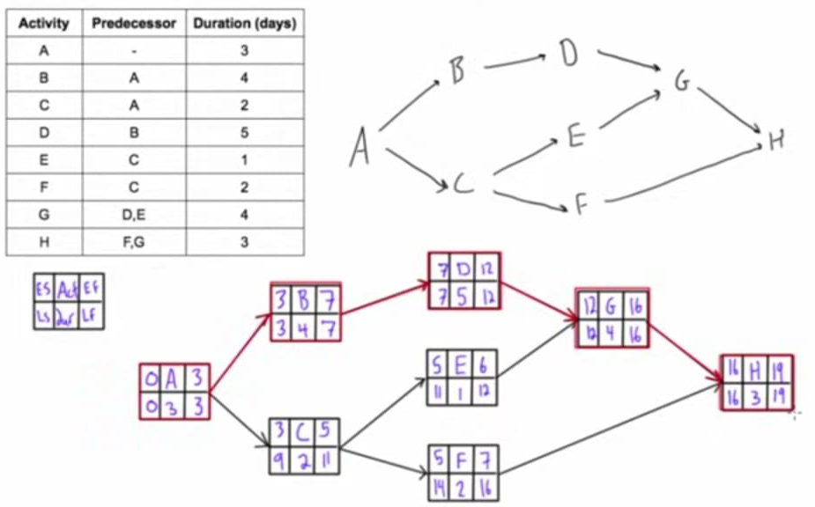

Slide 37
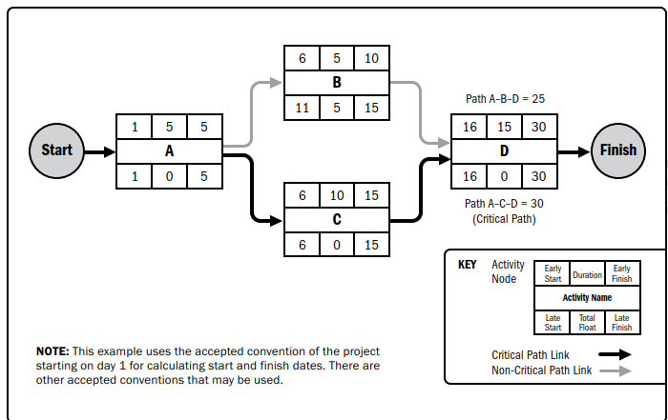

Slide 38
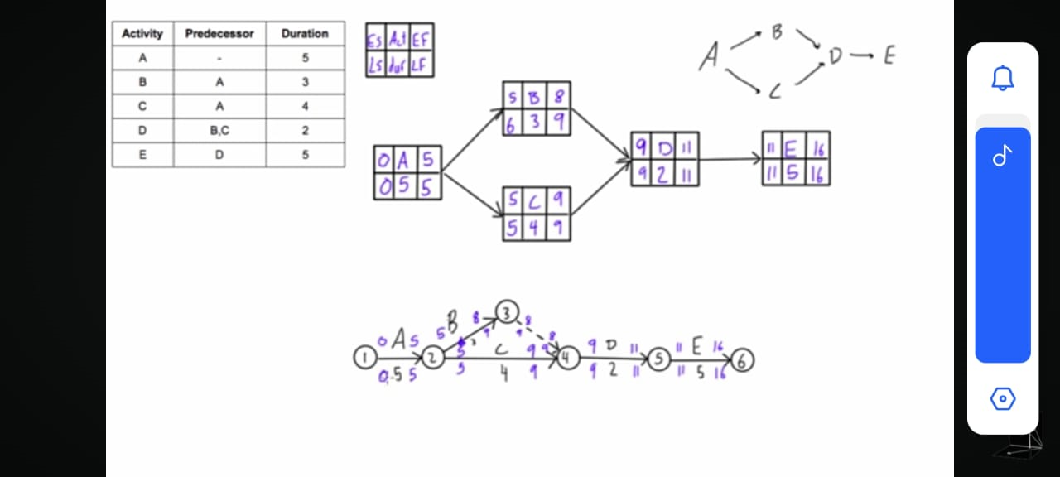
1: Draw a Network Diagram. Using a standard node convention to display the duration. ( Activity on Node and Activity on Arrow).
2. Apply forward and backward pass.
3. What is the critical path?
4. What is the project’s expected duration?
5: Calculate Float?

Slide 40
Reading Assignment
Chapter 6: Project Schedule Management by PMBOK-Guide-6th-Edition-PMI
(Book and Lecture Slides are already uploaded on resource link.)

Slide 41
THANK YOU

